Slide 1
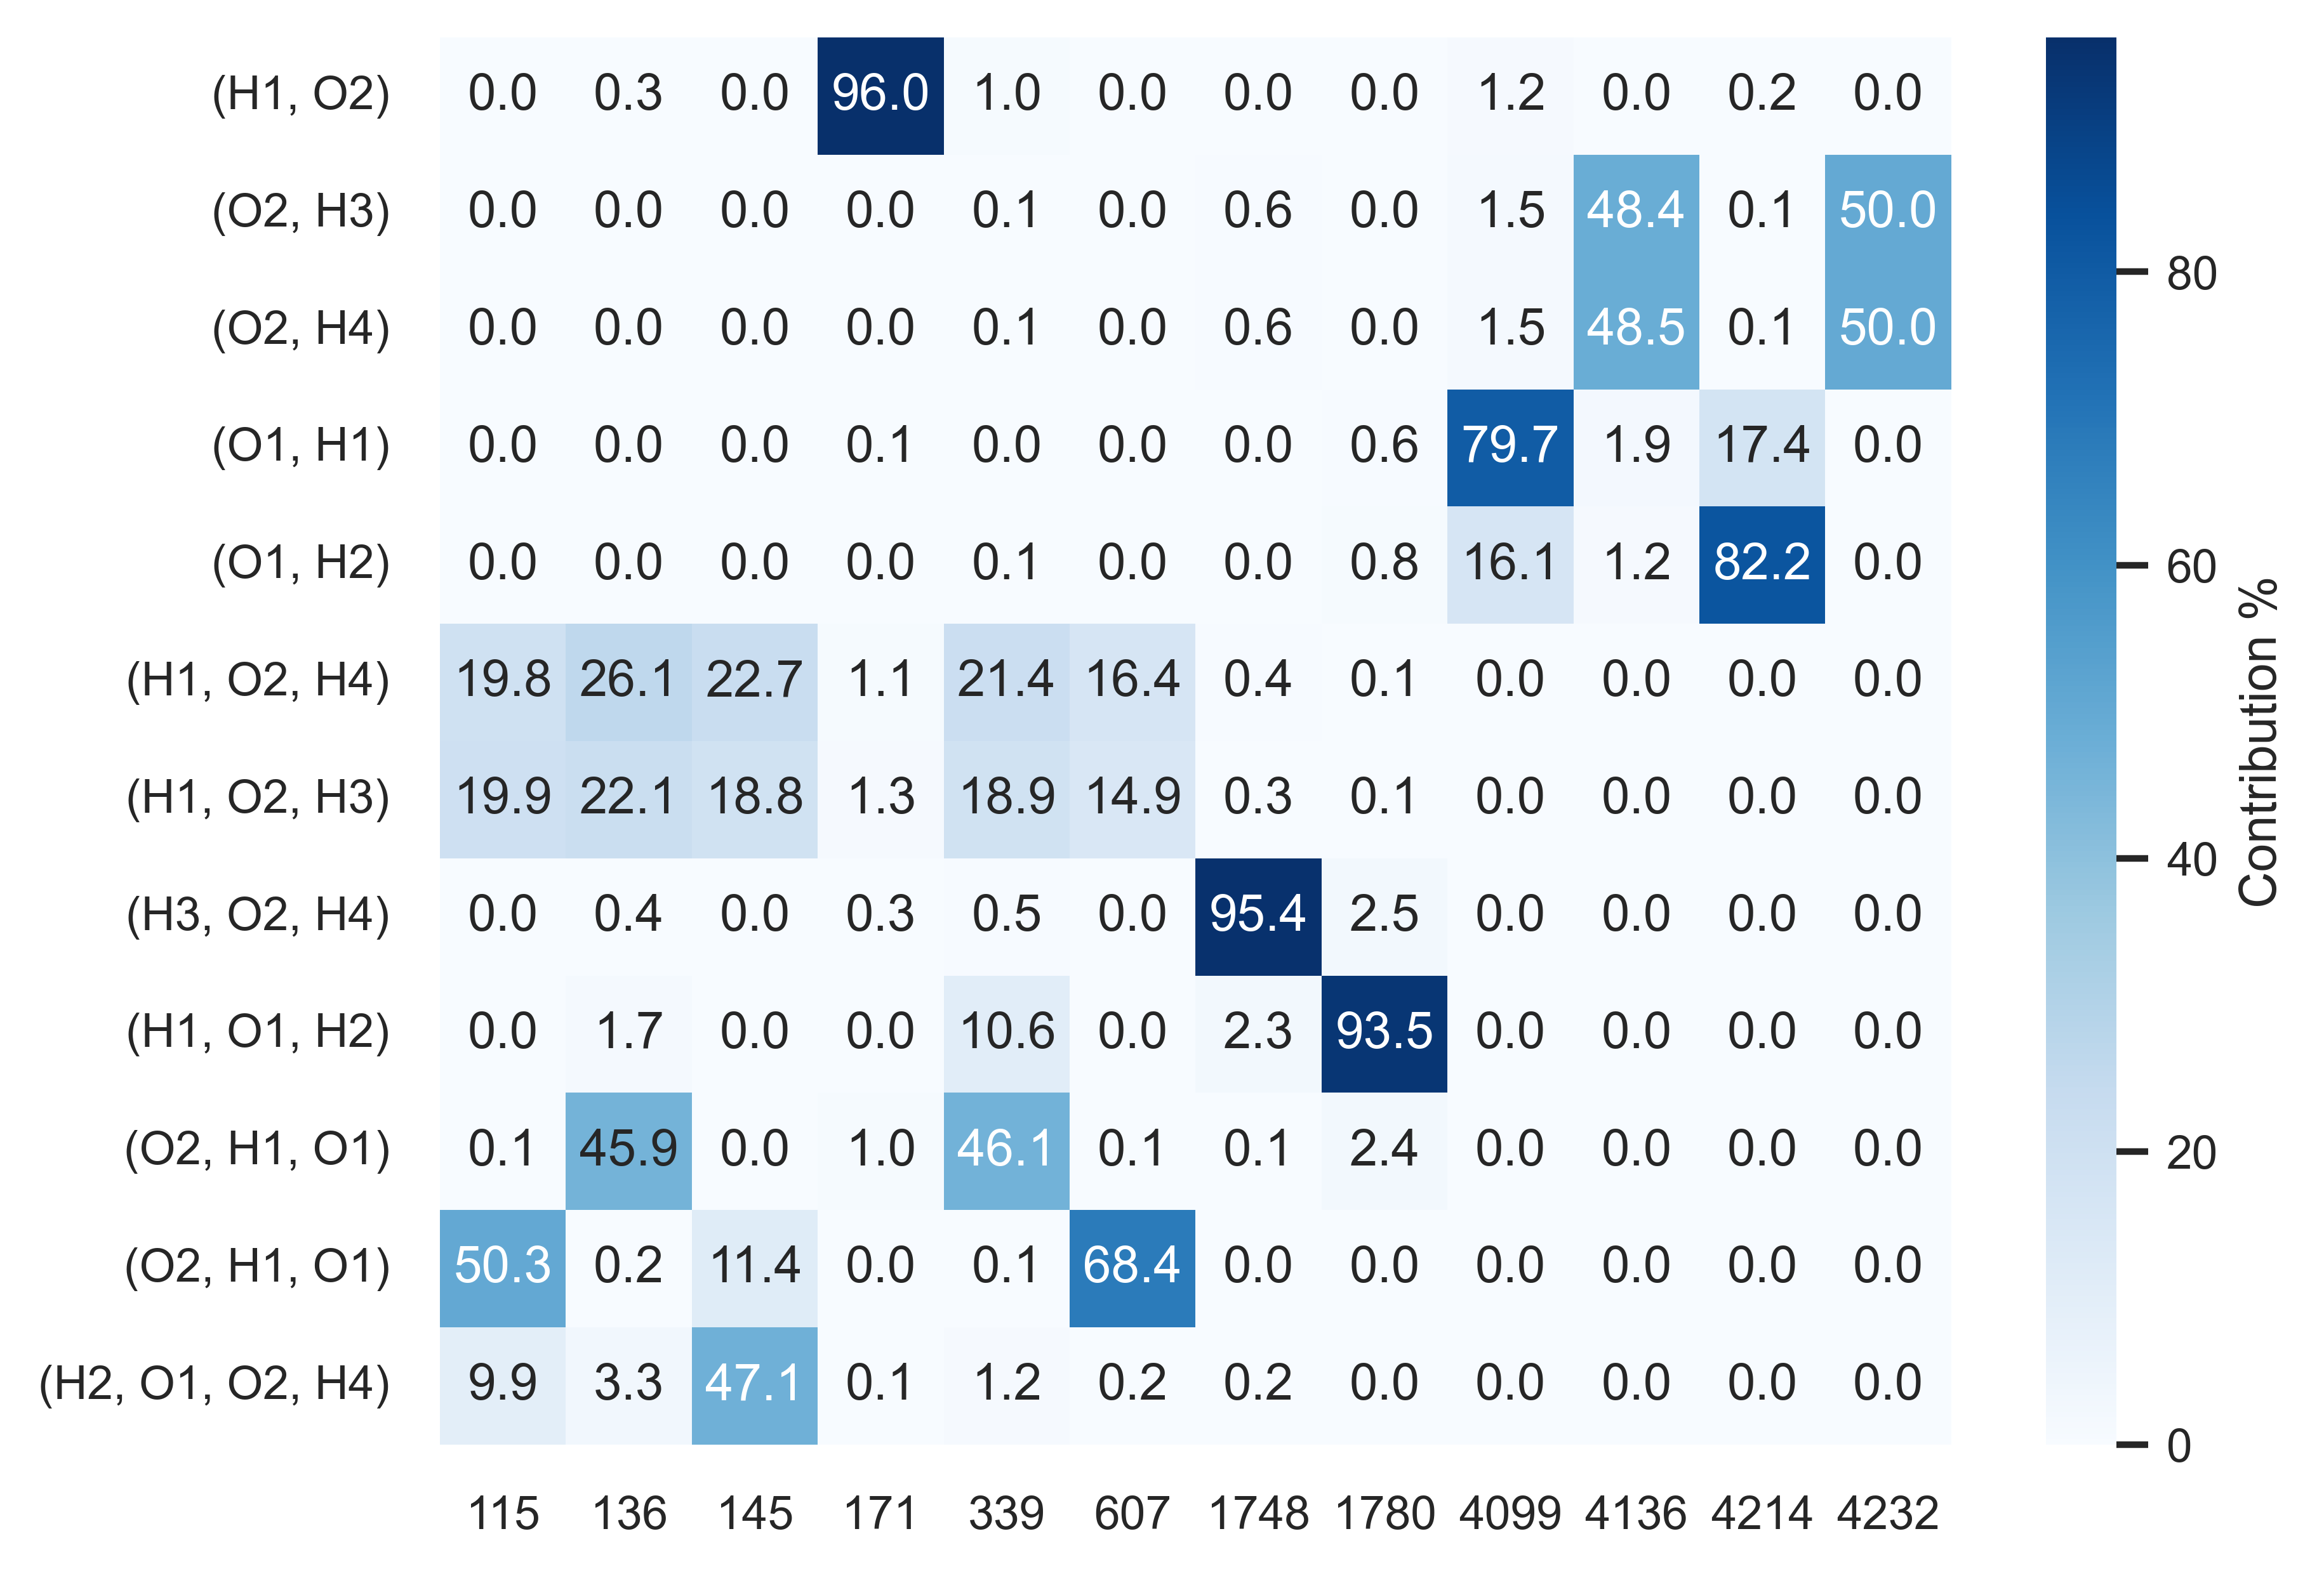
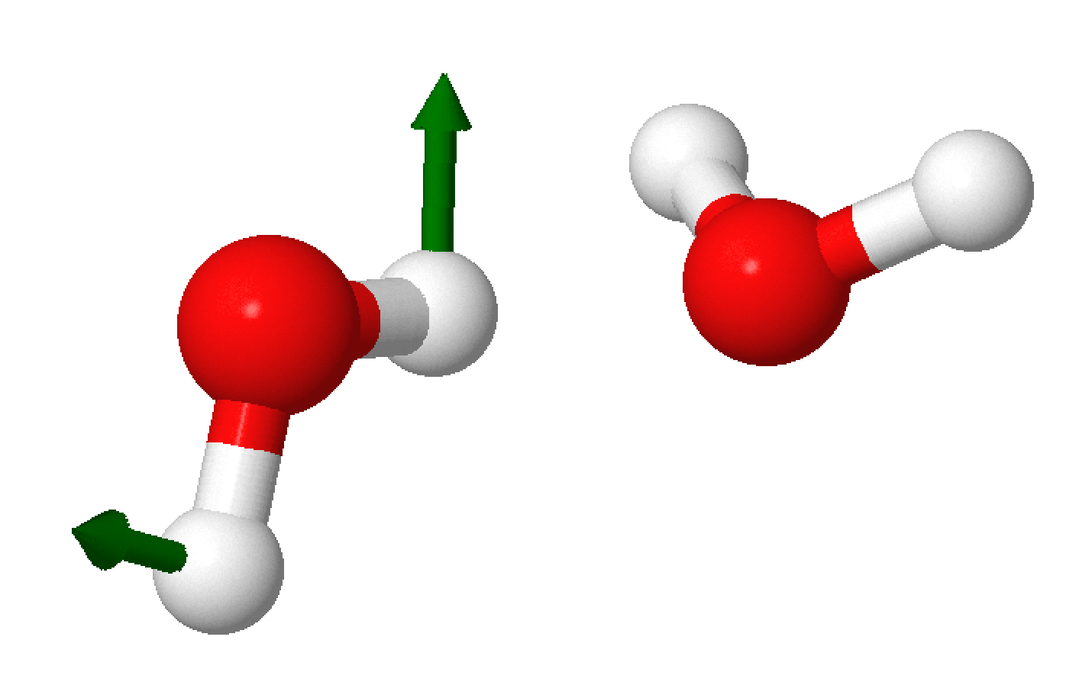
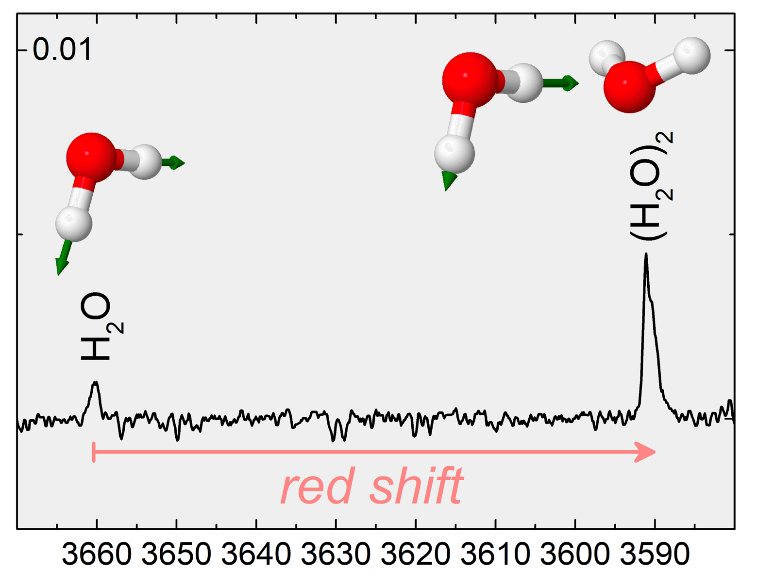
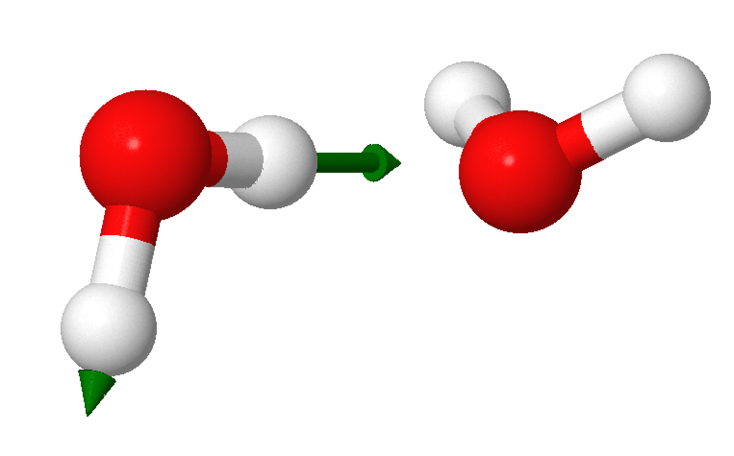
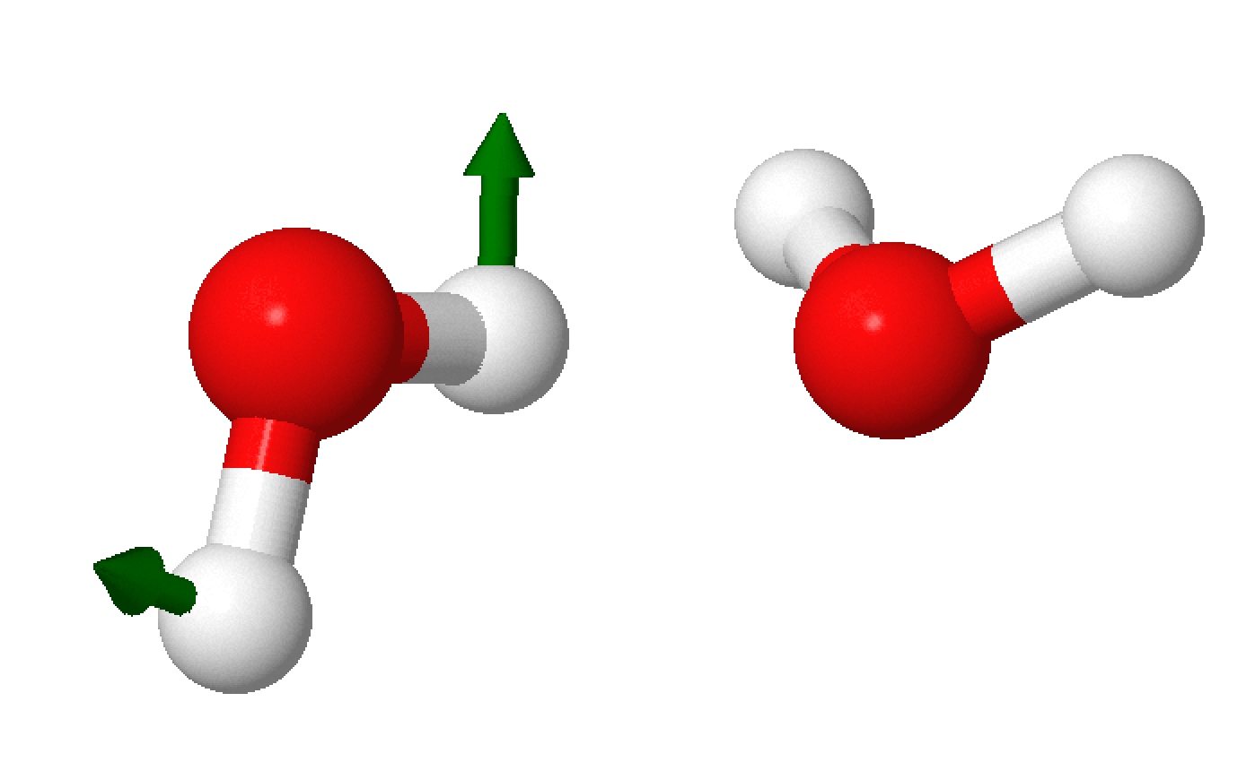
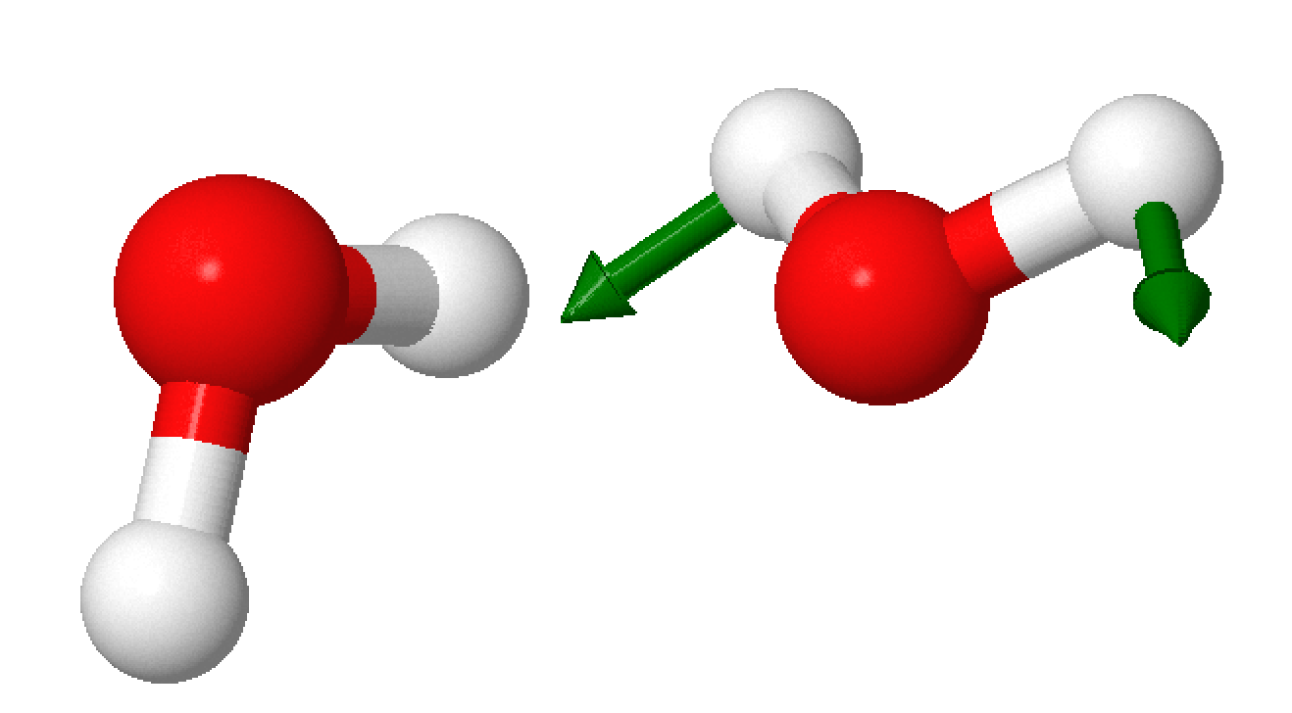


Towards Less Ambigous Vibrational Spectroscopic Notations for Hydrogen-Bonded Water and Methanol Clusters
Vibrational Modes
Normal Mode Decomposition
Labeling of IR-Vibrations
$ν_{s}$ monomer
$ν_{s}$ dimer
Conclusion:
Normal mode decomposition provides a strategy to derive vibrational notations.
Leave this blank for DOI and stuff if published?

Slide 2
Normal Mode Decomposition
Vibrational Notations
Pls add spectrum

